Slide 1
WK Kellogg Co 2025 Merchandising Catalog

Slide 2
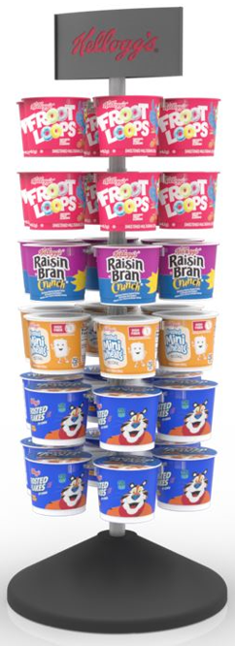
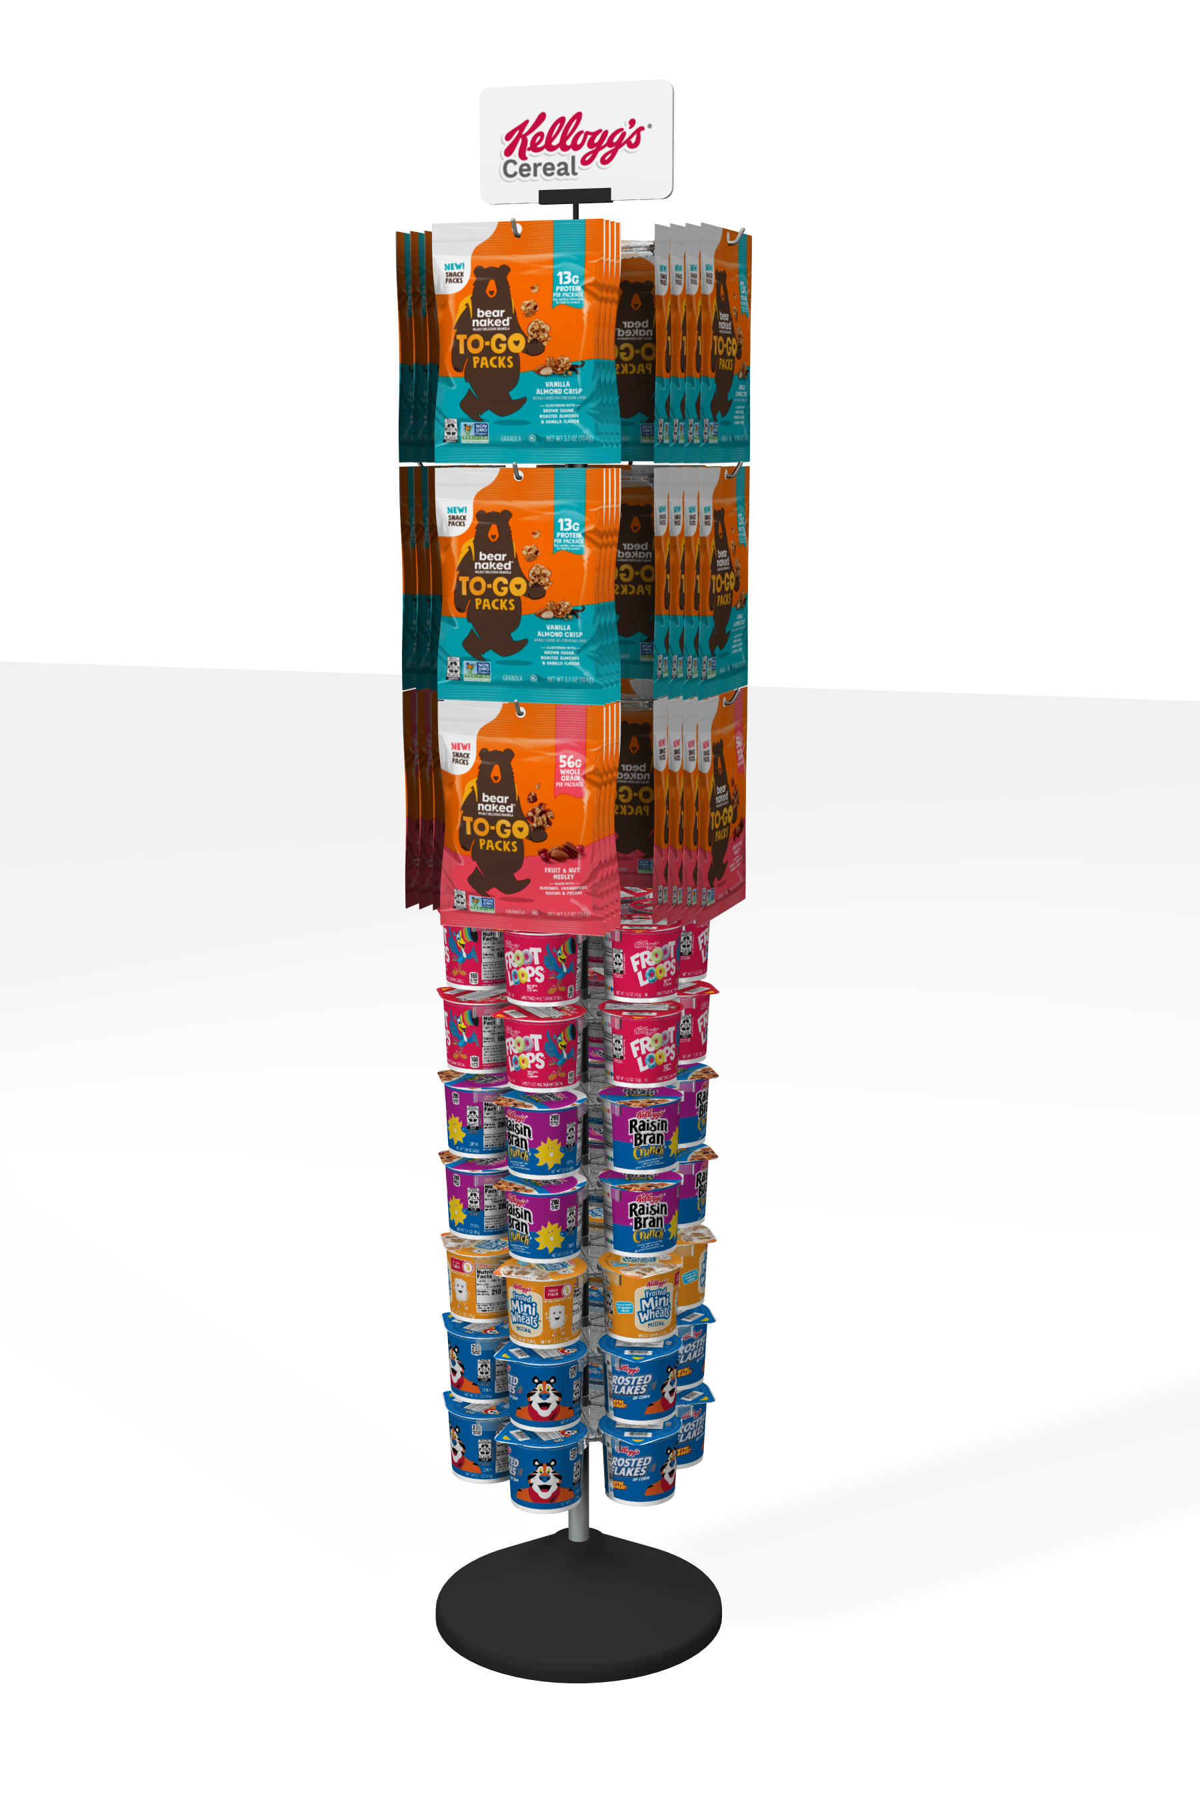
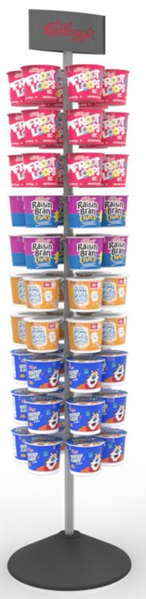
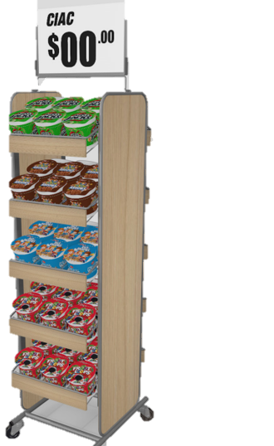
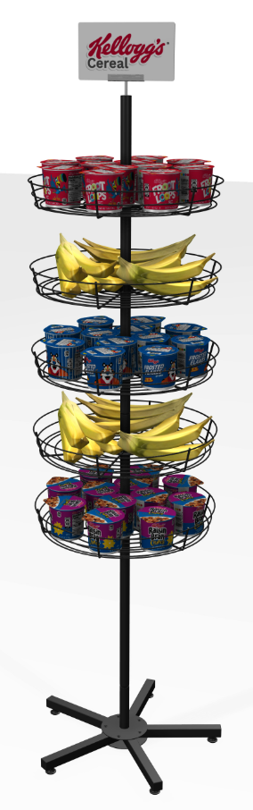
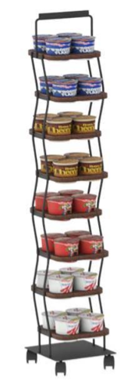
AWAY FROM HOME – DISPLAYS/POS
Item: 3010012477
Item: 92822
Item: 55242-1
Item: 55242-2
Item: 7182024
Item: 7202023
Dimensions:
11”W x 31”H x 11”D
Capacity: Holds 36 Individual Cups
Dimensions:
19.6”W x 69”H x 19.6”D
Capacity: Holds 48 Bags, 42 Individual Cups
Dimensions:
14”W x 61”H x x14”D
Capacity: Holds 60 Individual Cups
Dimensions:
14.75 ”W x 56.125”H x x17.375”D
Capacity: Holds 60 Individual Cups
Dimensions:
Capacity:
Dimensions:
10.5" x 11" x 48"H
Capacity: Holds 32 Individual Cups

Slide 3
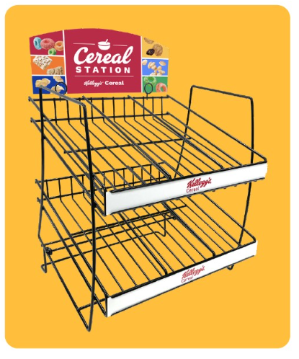

AWAY FROM HOME – DISPLAYS/POS
Item: 3202025
Item: 55242-2SIGNS
NEW!
Dimensions:
13”W x 16”H x 14.25”D
Capacity: Fits 24 Bowls, 36 I-Box, or 18 Cereal Cups

Slide 4
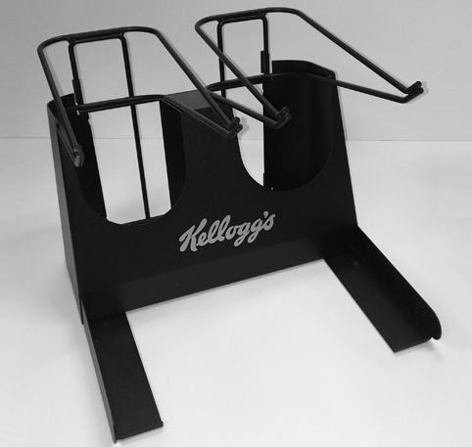
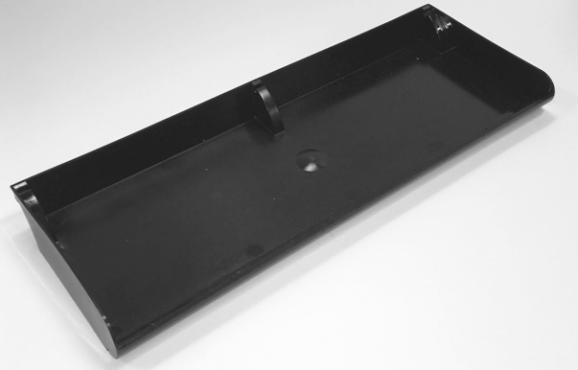
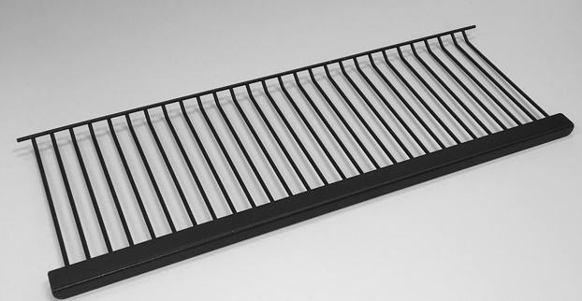
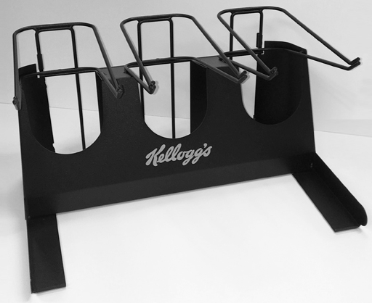
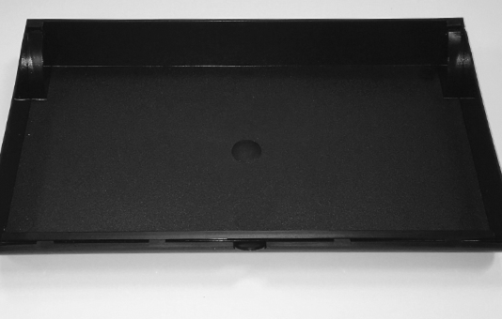
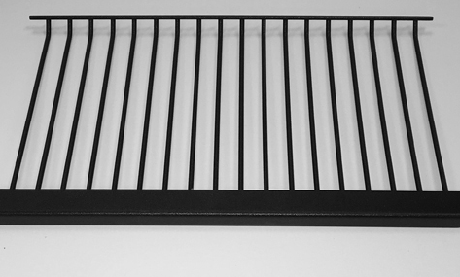
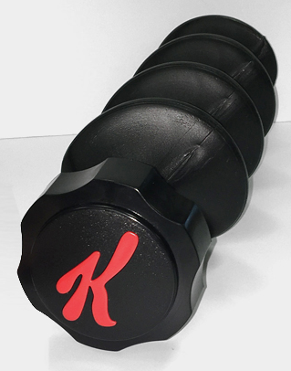
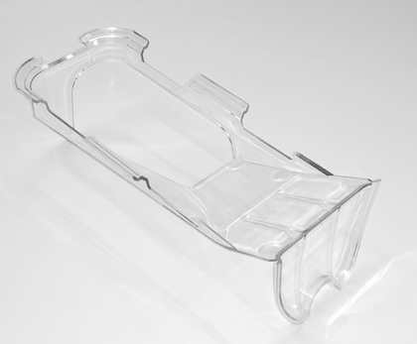
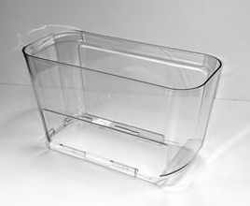
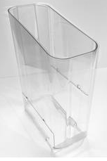
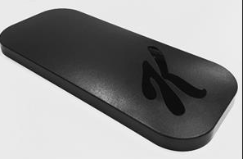
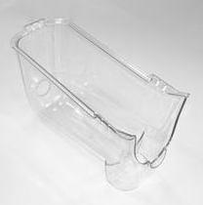

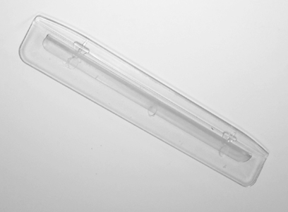
AWAY FROM HOME – BULK CEREAL DISPENSER EQUIPMENT
Item: 2WCTBCD
Item: 2WGBCD
Item: 2WSBBCD
Item: 3WCTBCD
Item: 3WGBCD
Item: 3WSBBCD
Item: 2WCTBCD
Item: AGRBCD
Item: LIDBCD
Item: DFTRYBCD
Item: SHOPBCD
Item: THOPBCD
Item: TRGHBCD
Item: BAFLBCD

Slide 5
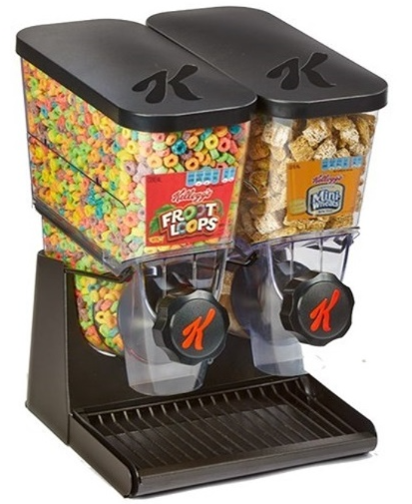
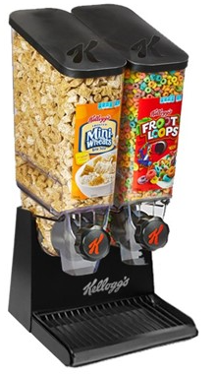
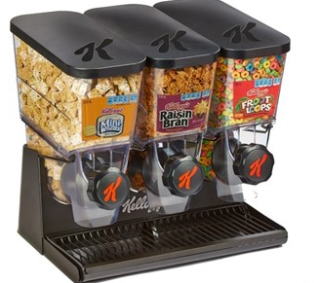
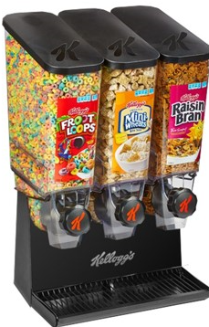
AWAY FROM HOME – BULK CEREAL DISPENSER EQUIPMENT
WHILE SUPPLIES LAST
WHILE SUPPLIES LAST
Item: BD2WS
Item: BD2WT
Item: BD3WS
Item: BD3WT
Dimensions:
12.5”W x 17.625”H x 13.75”D
Capacity: Holds approximately 640 fl. oz. or 80 Cups
Dimensions:
12.5”W x 26.125”H x 13.75”D
Capacity:
Holds approximately 1192 fl. oz. or 149 Cups
Dimensions:
18.375”W x 17.625”H x 13.75” D
Capacity:
Holds approximately 960 fl. oz. or 120 Cups
Dimensions:
18.375”W x 26.125”H x 13.75” D
Capacity:
Holds approximately 1788fl. oz. or 223.5 Cups

Slide 6
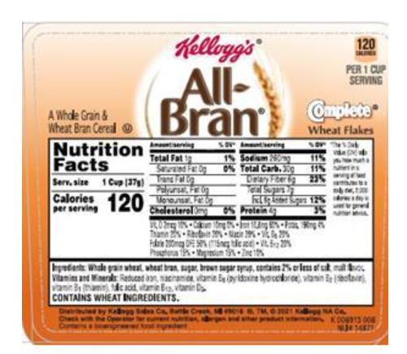
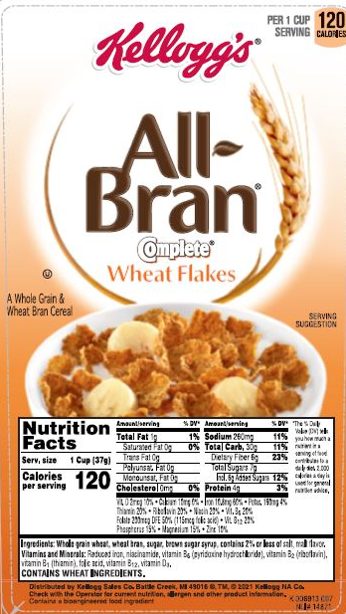
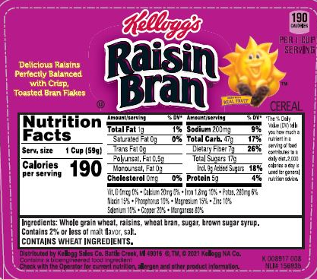
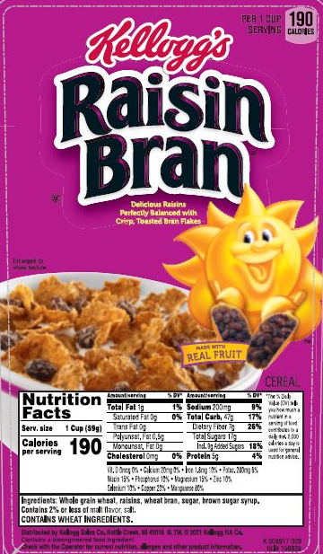
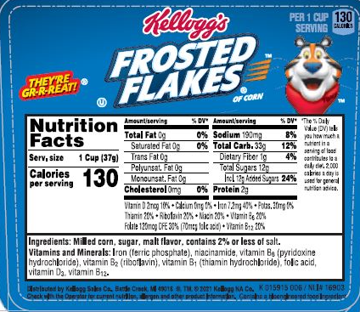
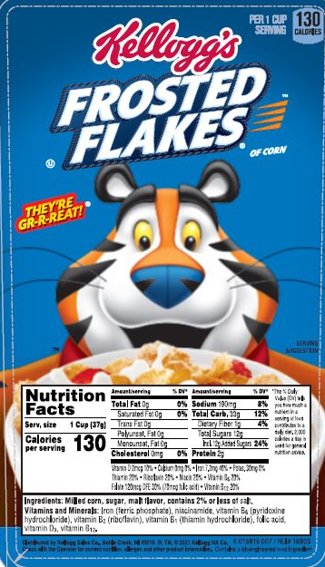
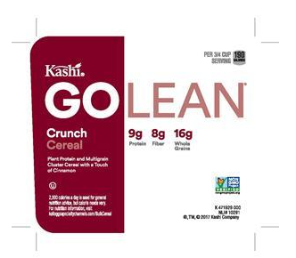
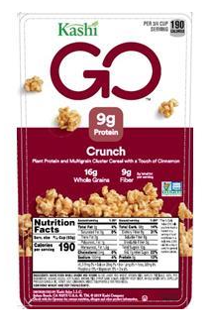
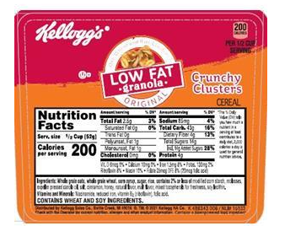
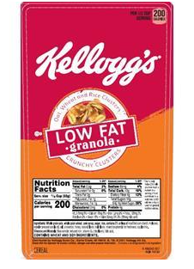
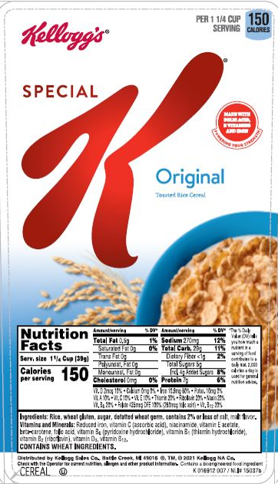
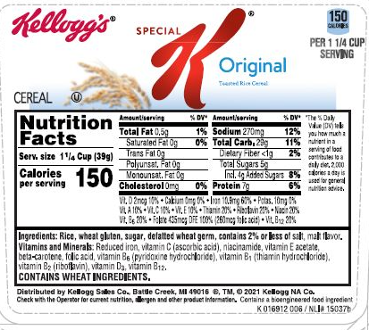
AWAY FROM HOME – BULK CEREAL DISPENSER LABELS
Item: K006913006
Item: K006913007
Item: K008917008
Item: K008917009
Item: K015915006
Item: K015915007
Item: K471929002
Item: K471929003
Item: K498343006
Item: K498343007
Item: K016912006
Item: K016912007

Slide 7
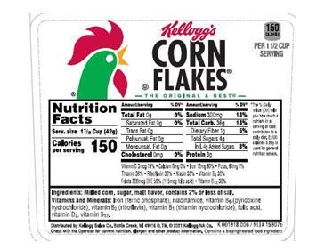
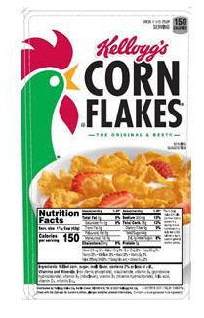
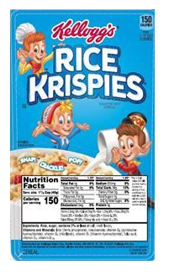
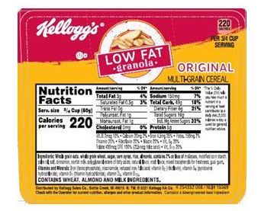
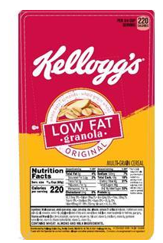
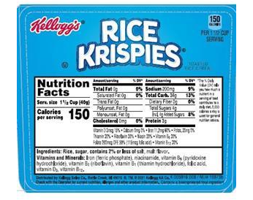
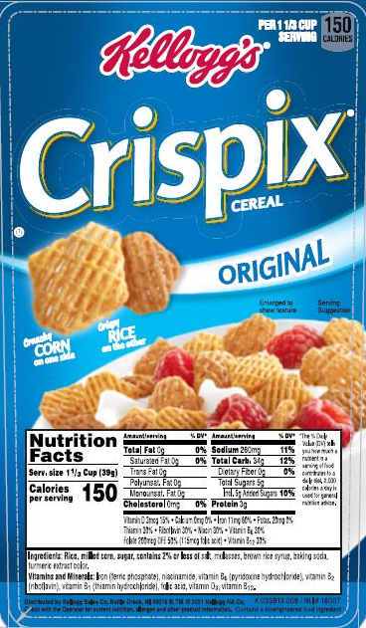
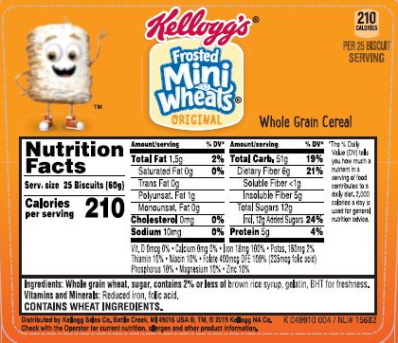
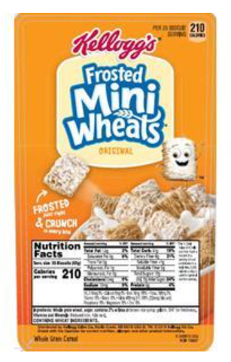
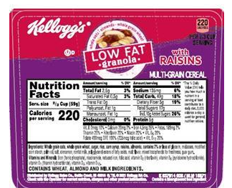
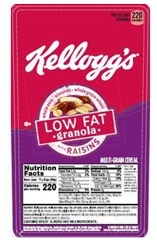
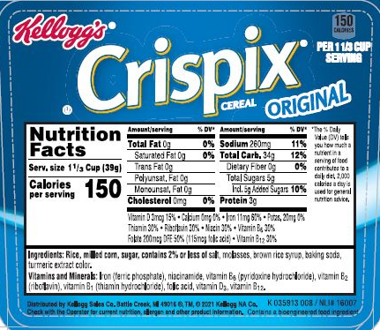
AWAY FROM HOME – BULK CEREAL DISPENSER LABELS
AWAY FROM HOME – BULK CEREAL DISPENSER LABELS
Item: K001918006
Item: K006913007
Item: K008917008
Item: K008917009
Item: K001918007
Item: K005916008
Item: K005916009
Item: K254352008
Item: K254352009
Item: K006913006
Item: K010910002
Item: K035913008
Item: K035913009
Item: K049910004
Item: K049910005
Item: K937914008
Item: K937914009

Slide 8
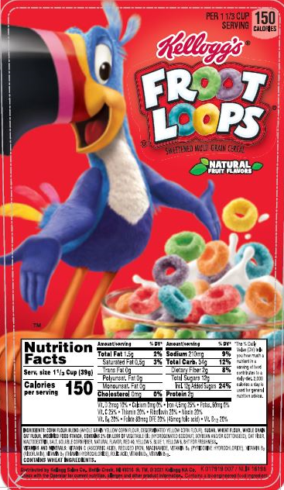
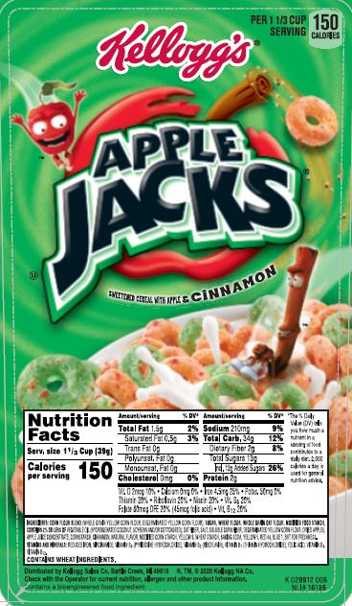








AWAY FROM HOME – BULK CEREAL DISPENSER LABELS
Item: K017919006
Item:K017919007
Item: K029912007
Item: K029912005
Item: K720109006
Item: K720109007
Item: K981665006
Item: K981665007
Item: SHORT LABEL SET
Item: TALL LABEL SET

