Slide 1
WK Kellogg Co
2026 AFH
Merchandising
Catalog

Slide 2
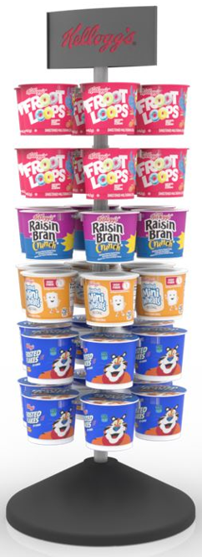
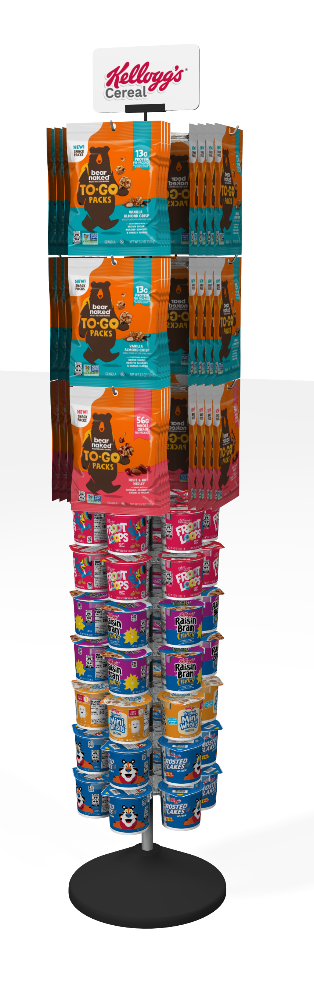
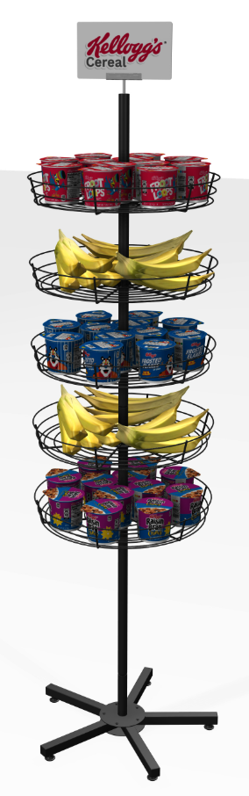
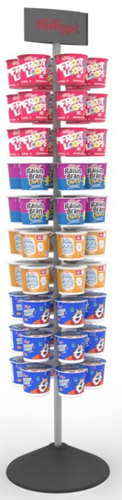
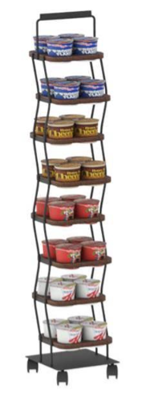
DISPLAYS/POS
Important! Users must use a mobile device that has SMX GO installed as well as logged in, for the blue links to work.
Item: 3010012477
Item: 92822
Item: 55242-1
Item: 07202023
Item: 7182024
CIAC 36-Cup Counter Spinner
Kellogg's CIAC Snacking Tree
CIAC 60-CT Floor Stand
CIAC 32ct Floor Stand
Breakfast Grab-n-Go Spinner
Dimensions:
11”W x 31”H x 11”D
Capacity:
Holds 36 Individual Cups
Dimensions:
20”W x 69”H x 20”D
Capacity:
Holds 48 Bags, 42 Individual Cups
Dimensions:
14”W x 61”H x x14”D
Capacity:
Holds 60 Individual Cups
Dimensions:
10.5“ x 11“ x 48“H
Capacity:
Holds 32 Individual Cups
Dimensions:
18“W x 72“H
Capacity:
Holds 60 Individual Cups

Slide 3
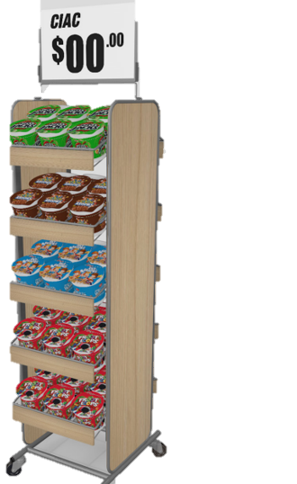
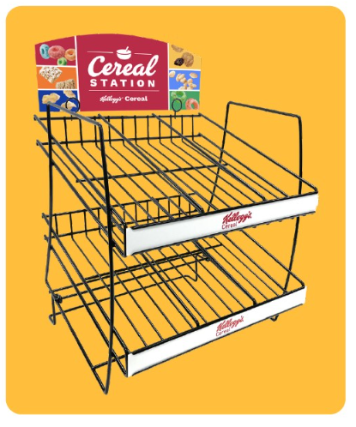

DISPLAYS/POS
Important! Users must use a mobile device that has SMX GO installed as well as logged in, for the blue links to work.
Item: 55242-2
Item: 55242-2SIGNS
Item: 3202025
CIAC 60ct Floor Rack
CIAC 60ct Floor Rack Signs
Single Dispenser
Dimensions:
14.75 ”W x 56.125”H x x17.375”D
Capacity:
Holds 60 Individual Cups
Dimensions:
13”W x 16”H x 14.25”D
Capacity:
Fits 24 Bowls, 36 I-Box, or 18 Cereal Cups

Slide 4
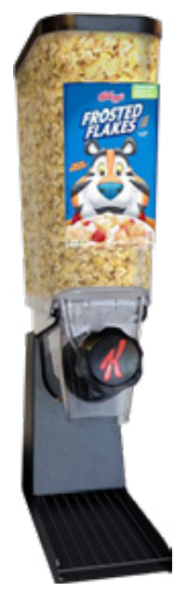
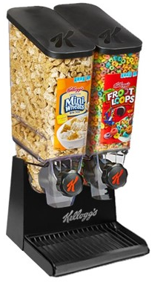
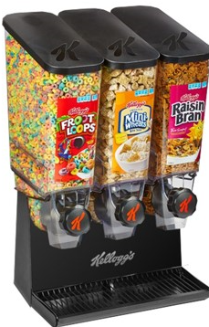
BULK CEREAL DISPENSERS
Important! Users must use a mobile device that has SMX GO installed as well as logged in, for the blue links to work.
Item: 1WTALL
Item: BD2WT
Item: BD3WT
Single Dispenser
Bulk Dispenser 2-Wide Tall
Bulk Dispenser 3-Wide Tall
Dimensions:
6.5”W x 26.125”H x 13.5”D
Capacity:
Holds approximately 596 fl. oz. or 74.5 cups
Dimensions:
12.5”W x 26.125”H x 13.75”D
Capacity:
Holds approximately 1192 fl. oz. or 149 Cups
Dimensions:
18.375”W x 26.125”H x 13.75” D
Capacity:
Holds approximately 1788fl. oz. or 223.5 Cups

Slide 5
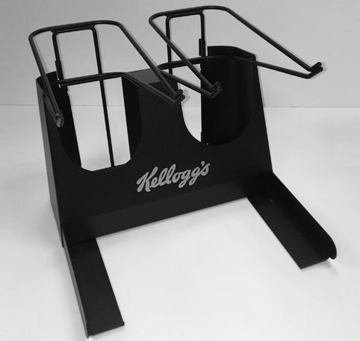
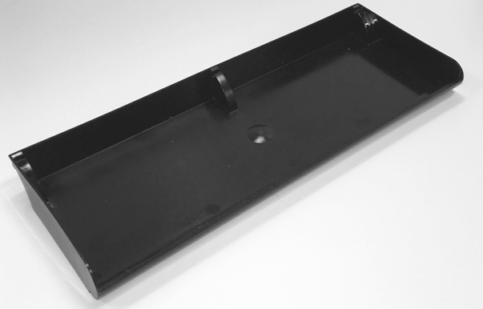
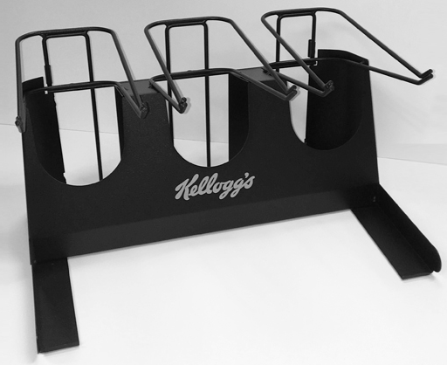
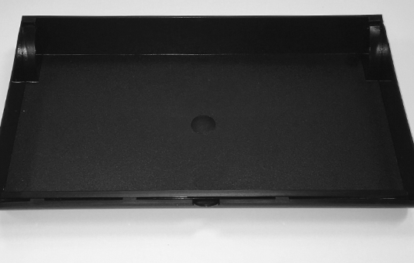
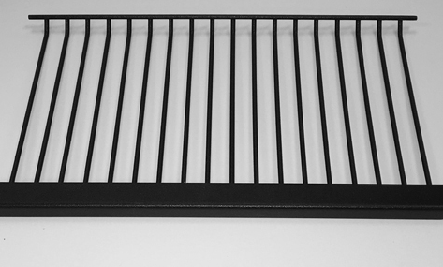
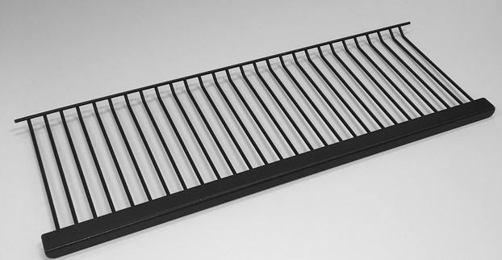
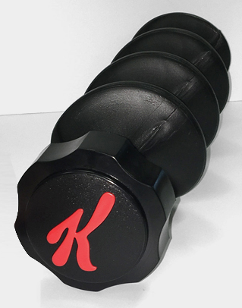
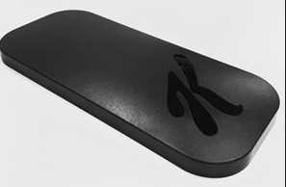
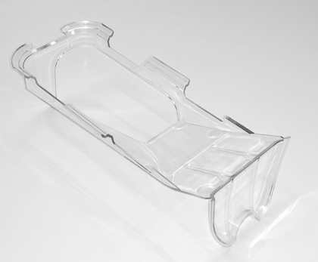
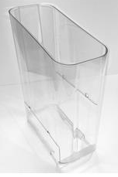
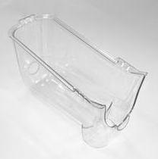
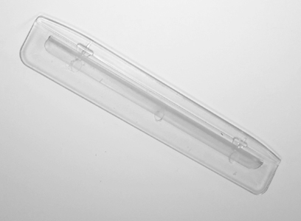
BULK CEREAL DISPENSER EQUIPMENT
Item: 2WCTBCD
Item: 2WGBCD
Item: 2WSBBCD
Item: 3WCTBCD
Item: 3WGBCD
Item: 3WSBBCD
2 Wide Crumb Tray
2 Wide Grate
2 Wide Base
3 Wide Crumb Tray
3 Wide Grate
3 Wide Base
Item: AGRBCD
Item: LIDBCD
Item: DFTRYBCD
Item: THOPBCD
Item: TRGHBCD
Item: BAFLBCD
Auger
Lid
Deflector Tray
Tall Hopper
Auger Trough
Baffle

Slide 6
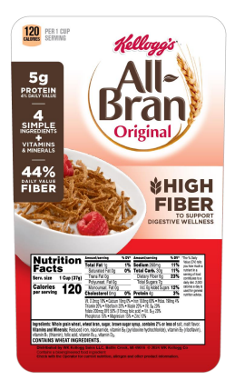
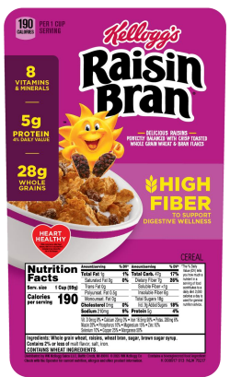
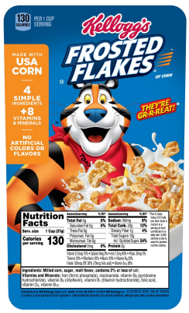
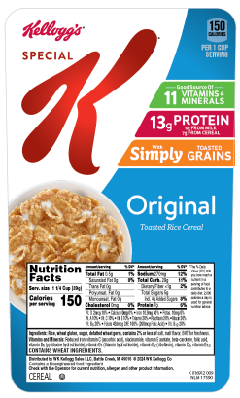
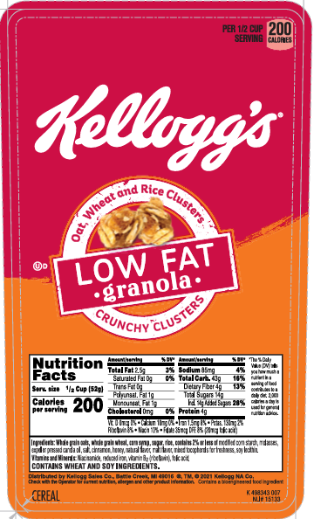
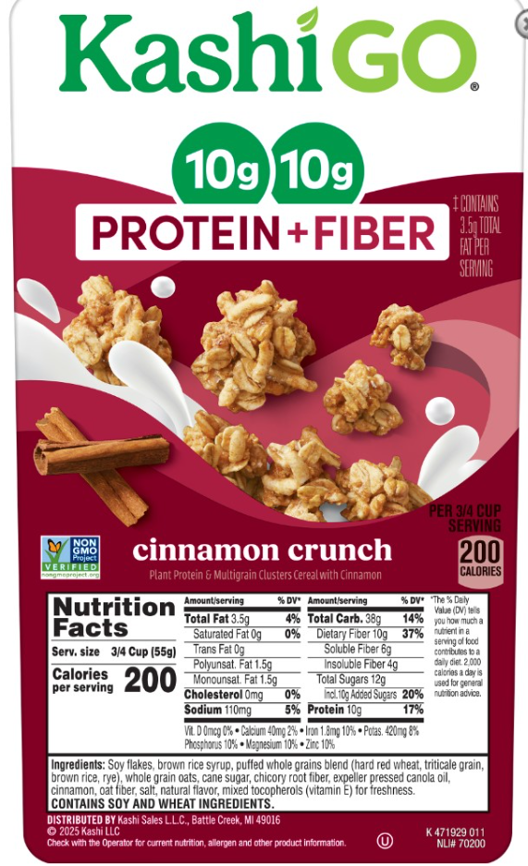
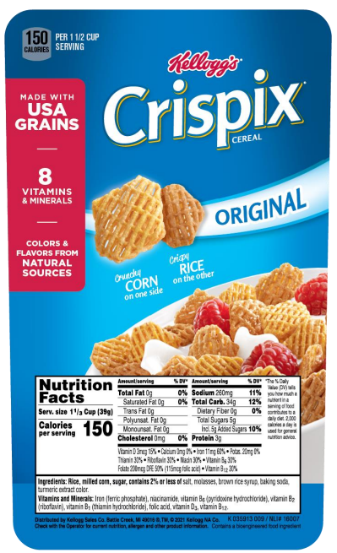
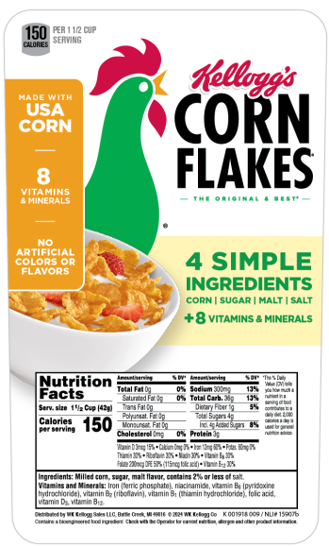
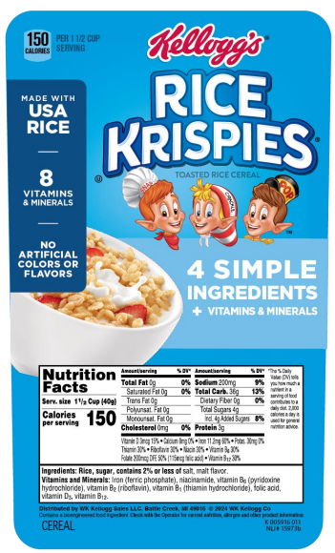
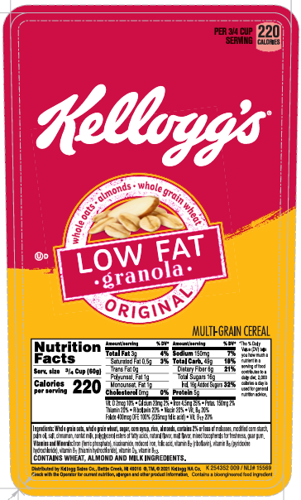
BULK CEREAL DISPENSER LABELS
Item: K 006913 007
Item: K 008917 009
Item: K 015915 007
Item: K 016912 007
Item: K 498343 007
Item: K 471929 003
Item: K 035913 009
Item: K 001918 007
Item: K 005916 009
Item: K 254352 009

Slide 7
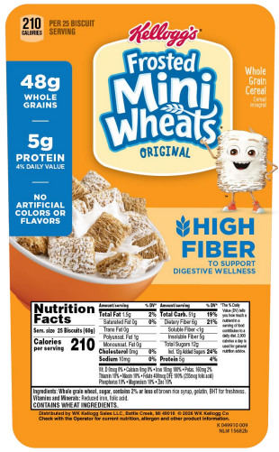
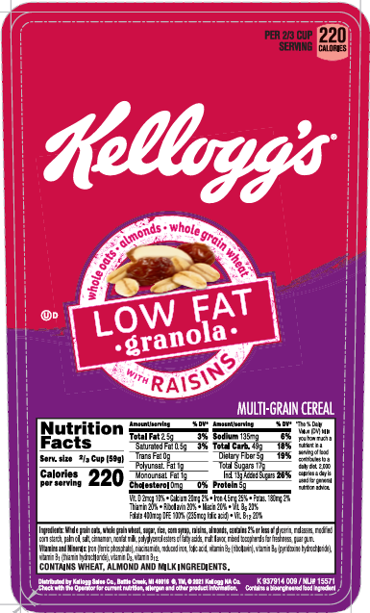
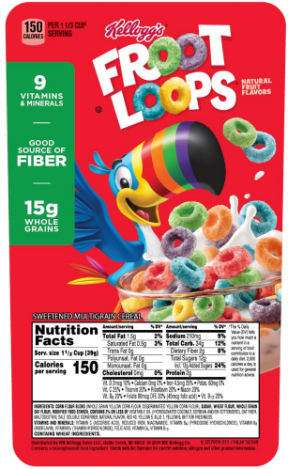
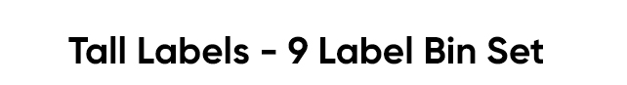
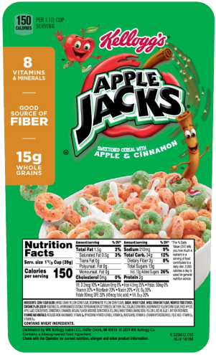
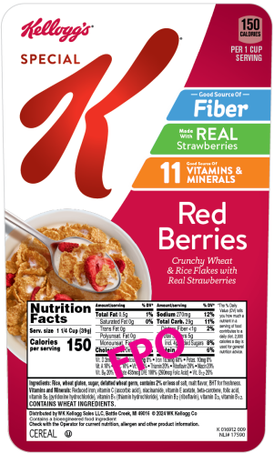
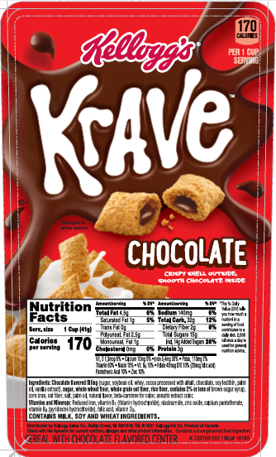
BULK CEREAL DISPENSER LABELS
Item: K 049910 005
Item: TALL LABEL SET
Item: K 006913 007
Item: K 937914 009
Item: K 017919 007
Item: K 981665 007
Item: K 720109 007
Item: K 029912 005

